Slide 1
Unit-3 Analysis

Slide 2
Unit-3 Analysis
Determining system requirements

Slide 3
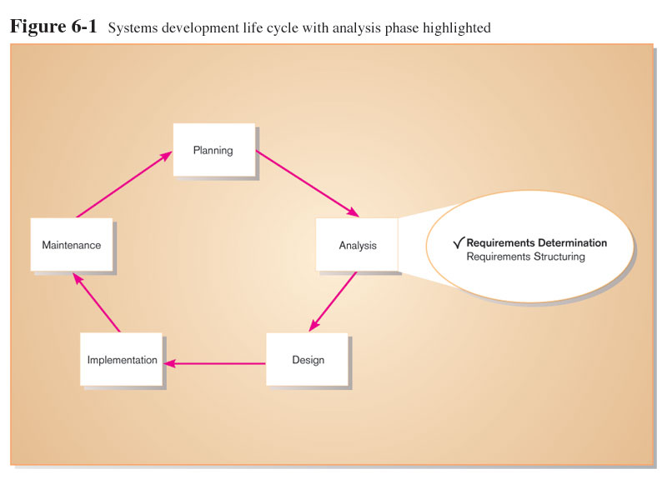
Performing Requirements Determination

Slide 4
The Process of Determining Requirements
Systems Analyst Characteristics for Successful Requirements Determination
Impertinence
Impartiality
Relaxing constraints
Attention to details
Reframing

Slide 5
Deliverables and Outcomes
Deliverables for Requirements Determination:
From interviews and observations - interview transcripts, observation notes, meeting minutes
From existing written documents - mission and strategy statements, business forms, procedure manuals, job descriptions, training manuals, system documentation, flowcharts

Slide 6
Deliverables and Outcomes (Cont.)
From computerized sources – Joint Application Design session results, CASE repositories, reports from existing systems, displays and reports from system prototype.

Slide 7
Traditional Methods for Determining Requirements
Interviewing individuals
Interviewing groups
Observing workers
Studying business documents

Slide 8
Interviewing and Listening
One of the primary ways analysts gather information about an information systems project.
Interview Guide is a document for developing, planning and conducting an interview.

Slide 9
Guidelines for Effective Interviewing
Plan the interview.
Prepare interviewee: appointment, priming questions.
Prepare agenda, checklist, questions.
Listen carefully and take notes (tape record if permitted).
Review notes within 48 hours.
Be neutral.
Seek diverse views.

Slide 10
Choosing Interview Questions
Each question in an interview guide can include both verbal and non-verbal information.
Open-ended questions: questions that have no pre specified answers.
Closed-ended questions: questions that ask those responding to choose from among a set of specified responses.

Slide 11
Interviewing Groups
Drawbacks to individual interviews
Contradictions and inconsistencies between interviewees.
Follow-up discussions are time consuming.
New interviews may reveal new questions that require additional interviews with those interviewed earlier.

